Slide 1
Classification of audio signals
Team 3
Byte Makes Right

Slide 2
Pre-processing
Audio samples
Denoising
Feature-Extraction
number of samples
Piano-600
Violin-580
Voice-590
FFT and IFFT
Using Librosa

Slide 3
Dataset
MFCC
Chroma features
RMS, Zero crossing rate
Spectral centroid, bandwidth, rolloff
Represent envelope of spectra
Attribute of pitches
Time domain features (Temporal features)
Frequency based featues (Spectral features)

Slide 4
Process
PCA
Train-Test split
components out of
Applying different models
Selection of best model
KNN, Random Forest, SVM, XGBoost
Random Forest

Slide 5
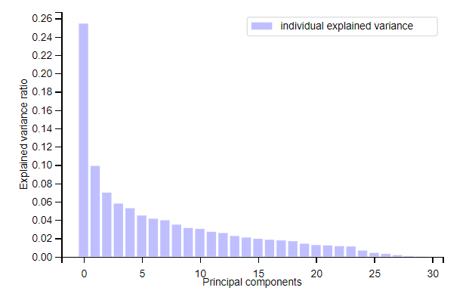
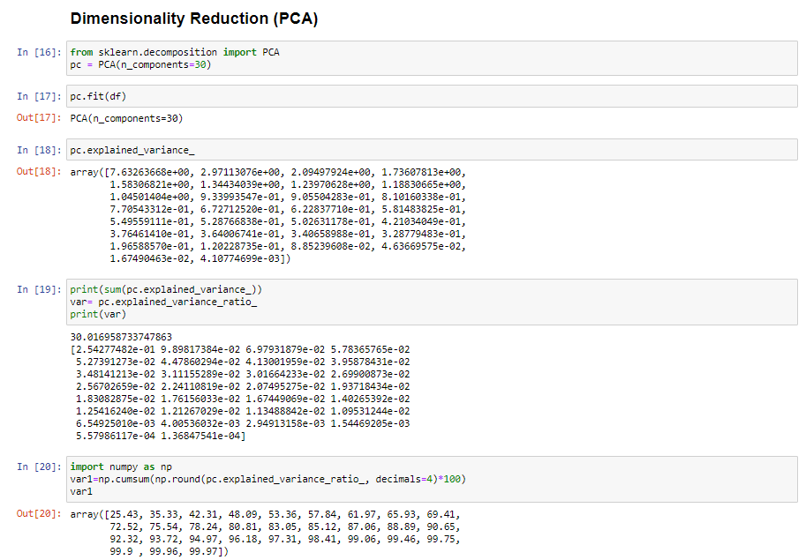
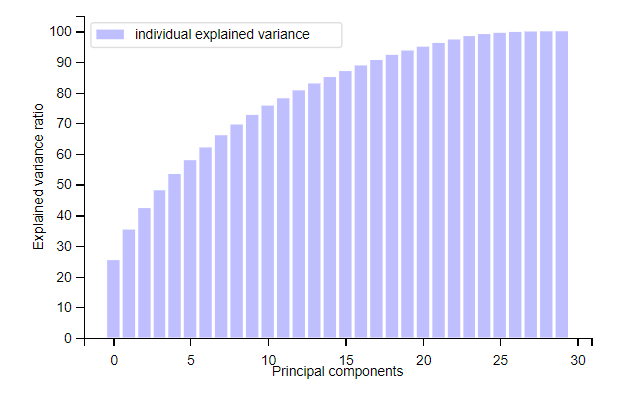
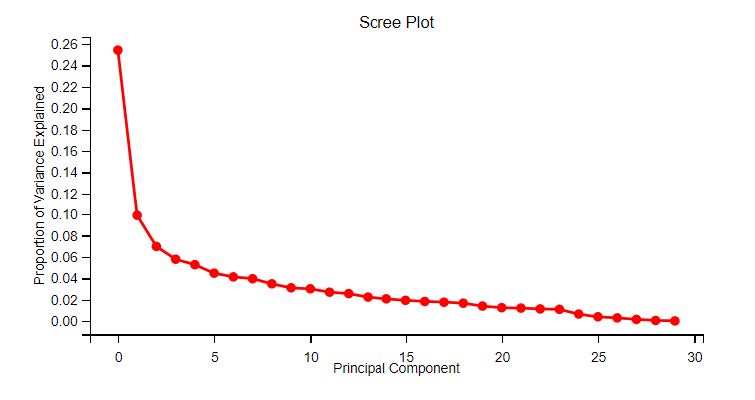

Slide 6
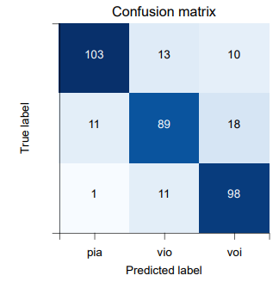
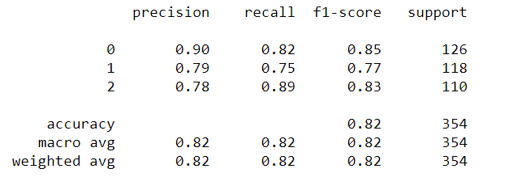
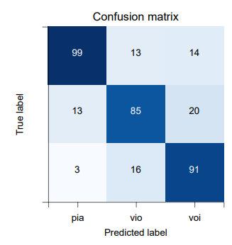
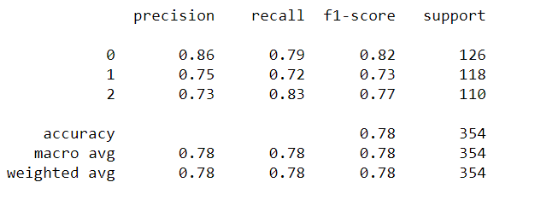
SVM
Random Forest

Slide 7
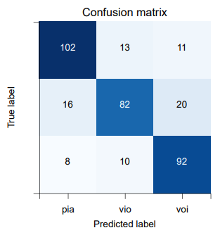
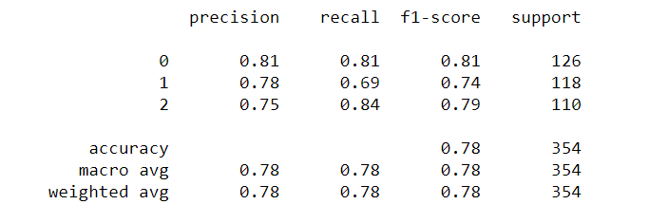
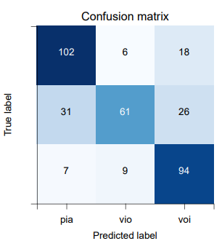
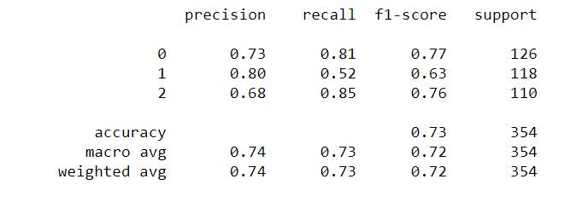
XGBoost
KNN

Slide 8
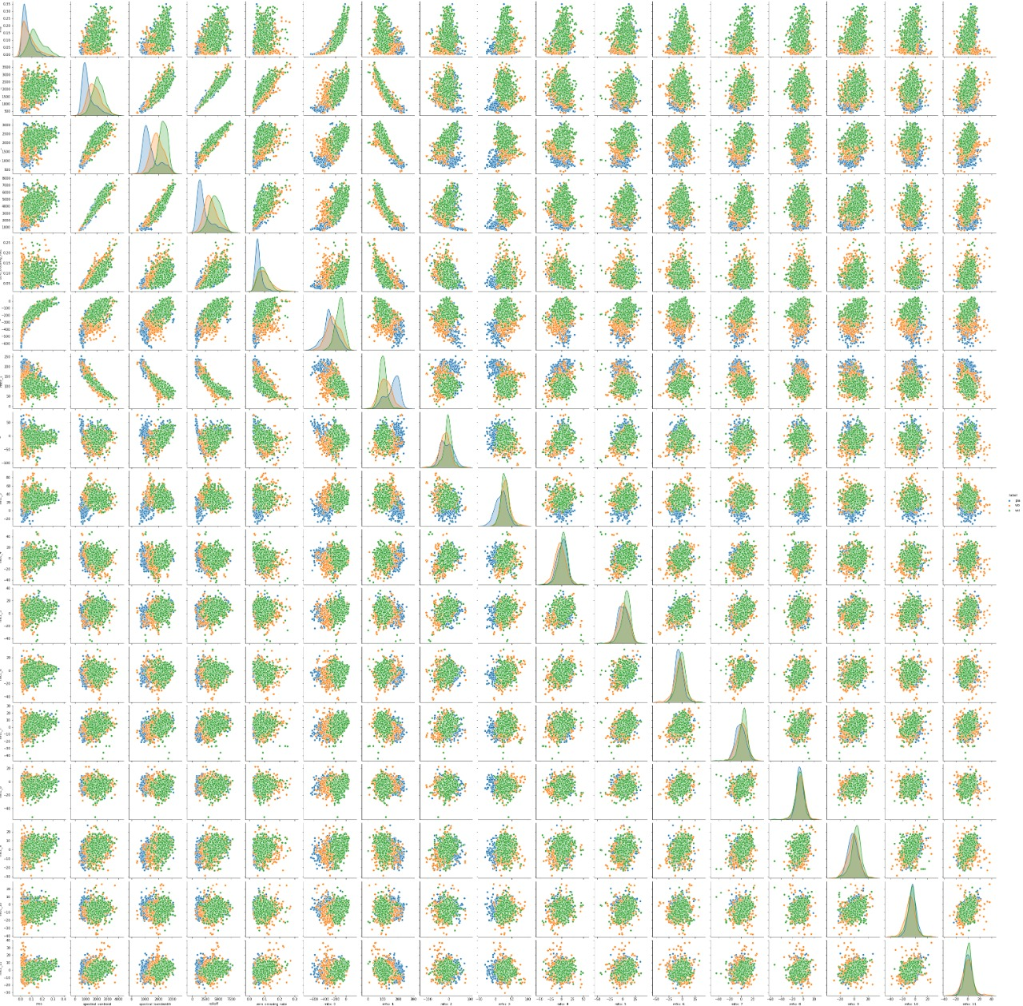

Slide 9

Conclusion
Steps
Feature Extraction
Scale transformation
PCA transformation
Apply in models
Audio is violin

Slide 10
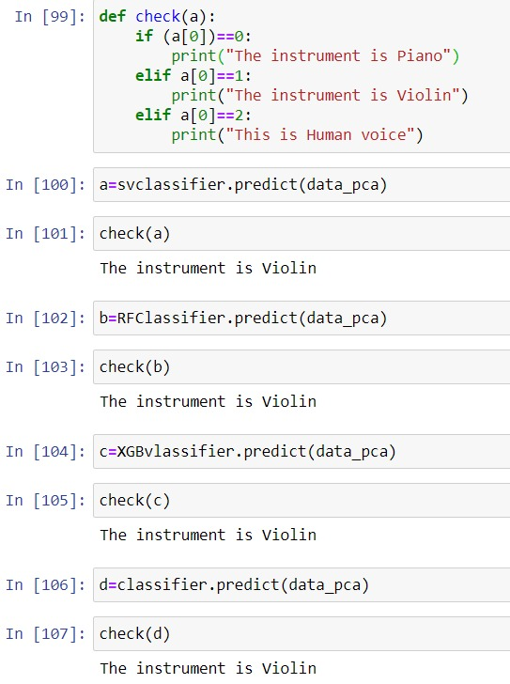
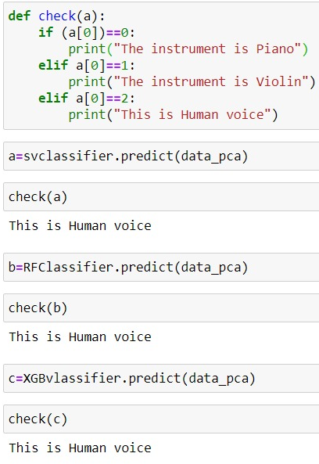
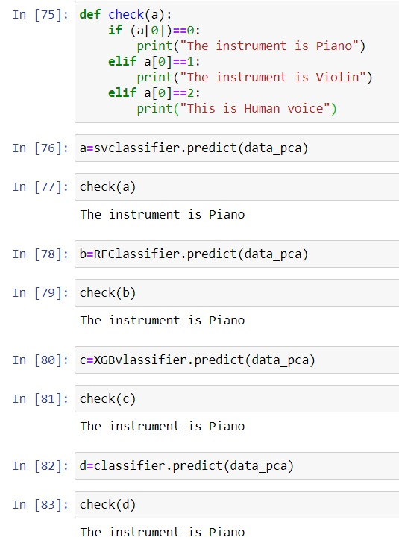

Slide 11
Thank you

